Slide 1
MonGO DB
NoSQL

Slide 2
What is it?
A document-oriented database – documents encapsulate and encode data (or information) in some standard formats or encodings
NoSQL database – non-adherence to the widely used relational database – highly optimized for retrieve and append operations
uses BSON format
schema-less – No more configuring database columns with types
No transactions
No joins

Slide 3
The BASICS
A MongoDB instance may have zero or more databases
A database may have zero or more collections. – Can be thought of as the relation (table) in DBMS, but with many differences.
A collection may have zero or more documents. – Docs in the same collection don’t even need to have the same fields – Docs are the records in RDBMS – Docs can embed other documents – Documents are addressed in the database via a unique key
A document may have one or more fields.
MongoDB Indexes is much like their RDBMS counterparts.

Slide 4
The BASICS
Simple queries
Makes sense with most web applications
Easier and faster integration of data
Not well suited for heavy and complex transactions systems.

Slide 5
MonGO DB vs RDBMS
Collection vs Table
Document vs row
Field vs Column
Schema-less vs Schema-Oriented

Slide 6
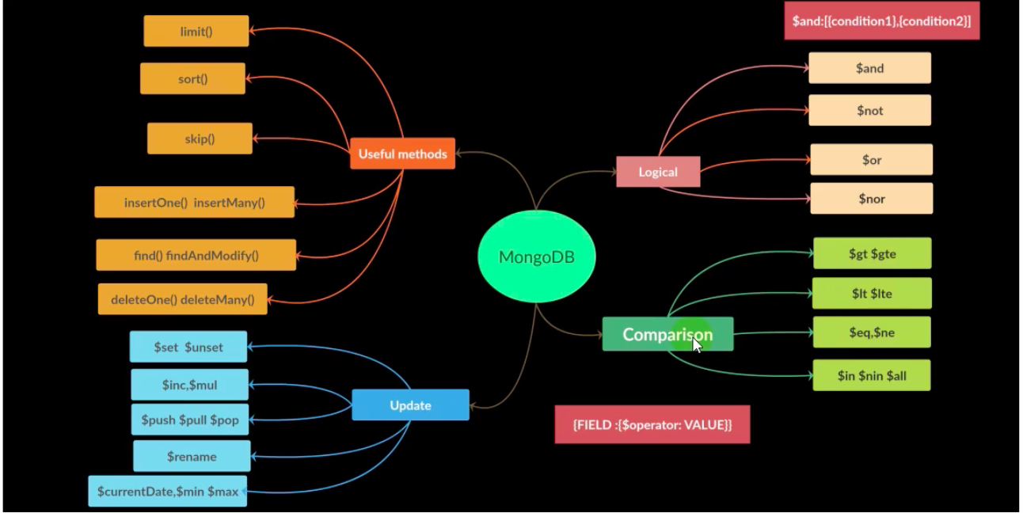
FIND Functions

Slide 7
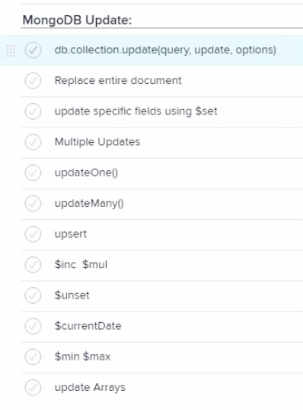
UPDATE Functions

Slide 8
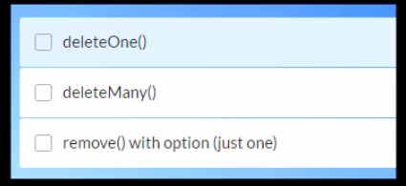
DELETE Functions

Slide 9
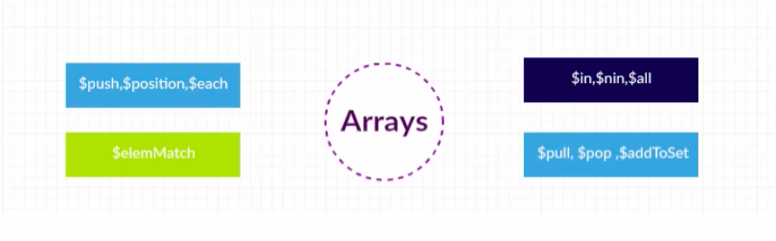
Arrays Functions

Slide 10
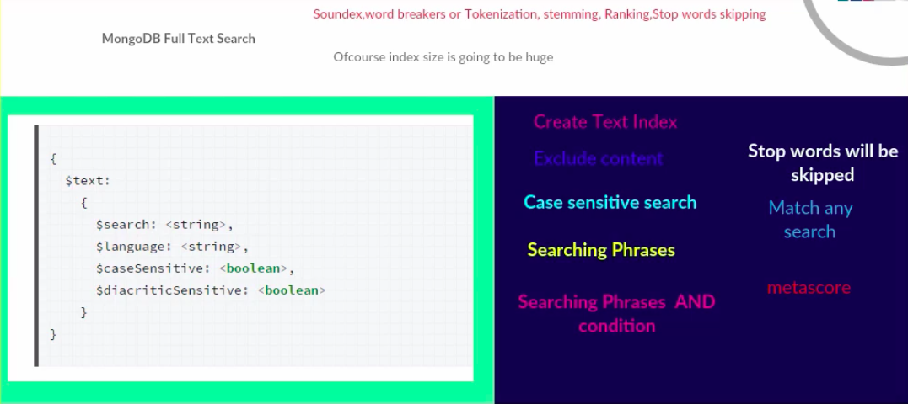
TEXT-SEARCH

Slide 11
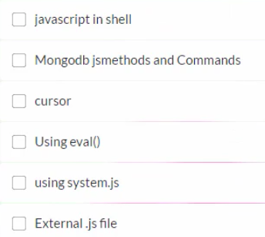
Javascript with MONGO DB

Slide 12
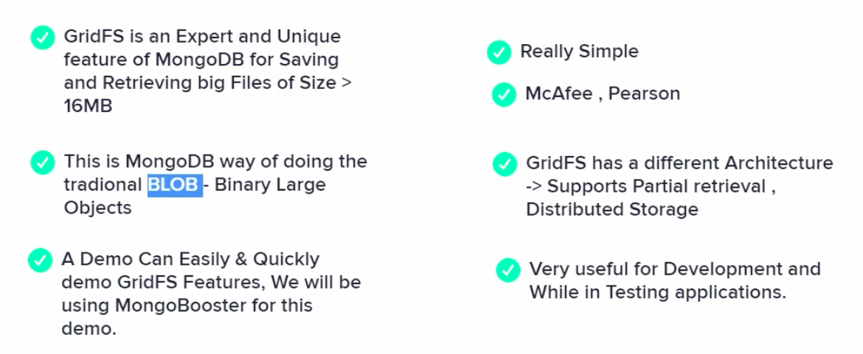
GRIDFS

Slide 13
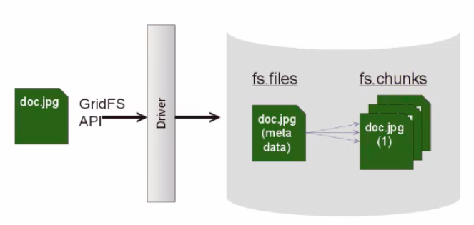
GRIDFS

Slide 14
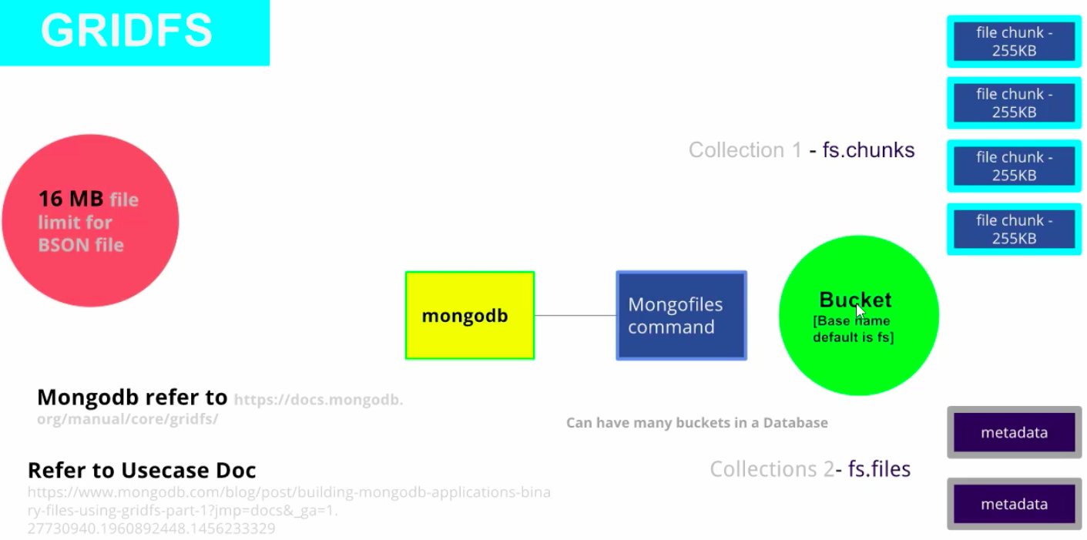
GRIDFS

Slide 15
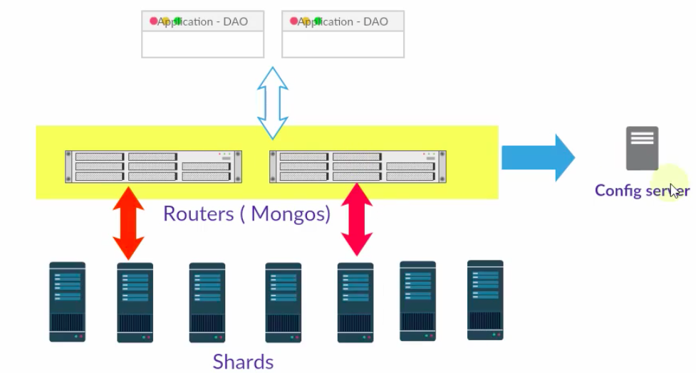
SHARDING

Slide 16
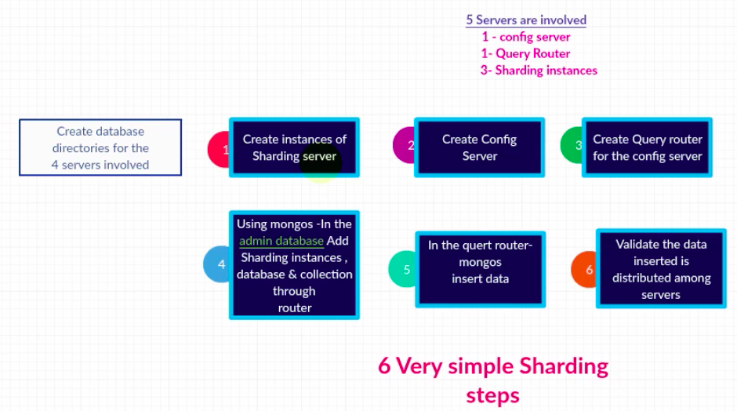
SHARDING - STEPS

Slide 17
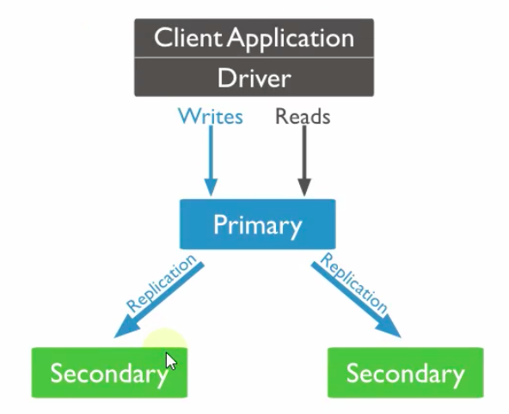
REPLICATION

Slide 18
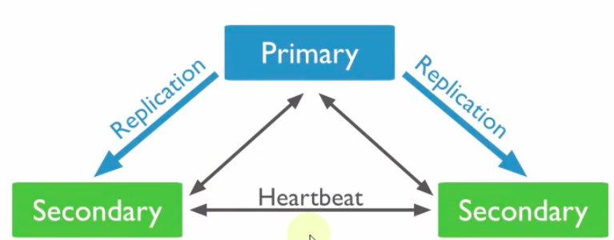
REPLICATION

Slide 19
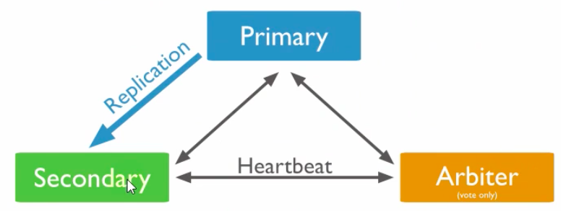
REPLICATION

Slide 20
QuEry OPTIMIZATION
Create an index to support read operations
Query selectively for smaller results
Using $match in aggregate functions
Covered query
db.inventory.createIndex( { type: 1, item: 1 }
db.inventory.find(
{ type: "food", item:/^c/ },
{ item: 1, _id: 0 }
)
db.collection.explain()

